Slide 1
Angular ReactiveForms
Timmy K Tom
Tata Consultancy Services

Slide 2
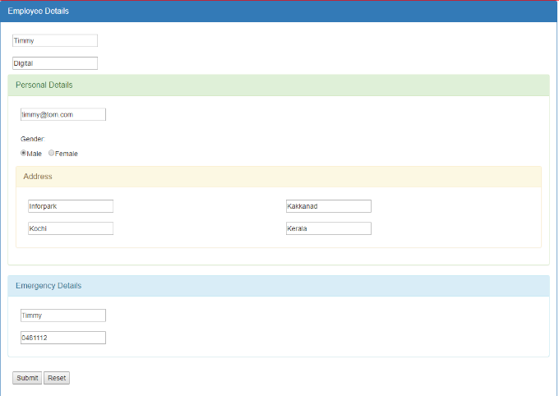

Slide 3
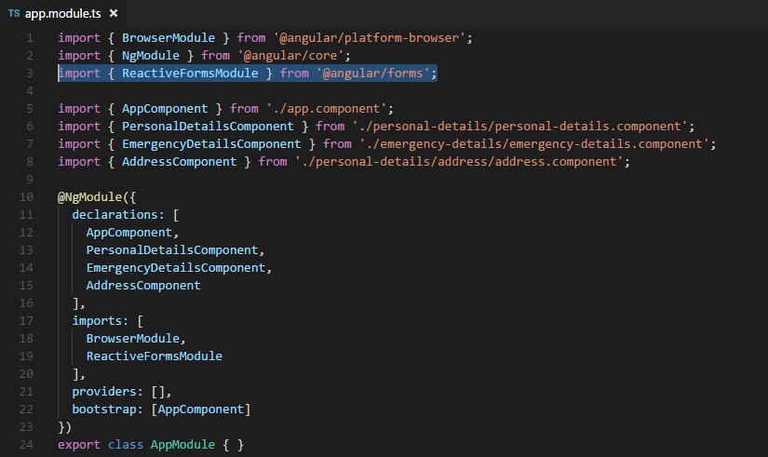

Slide 4
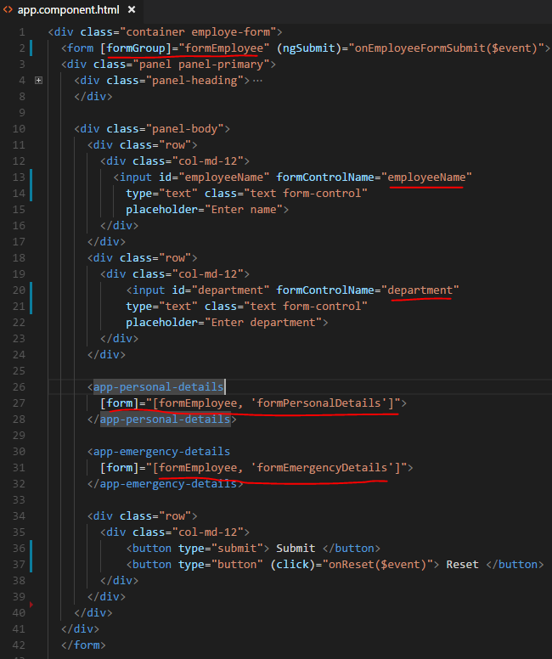
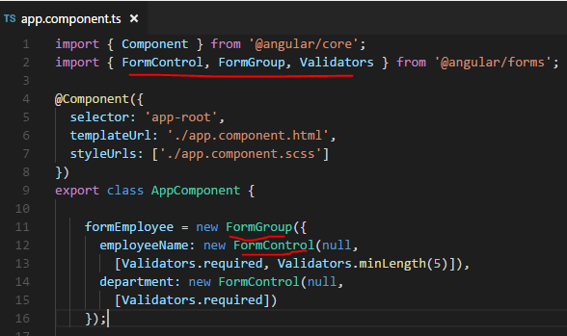
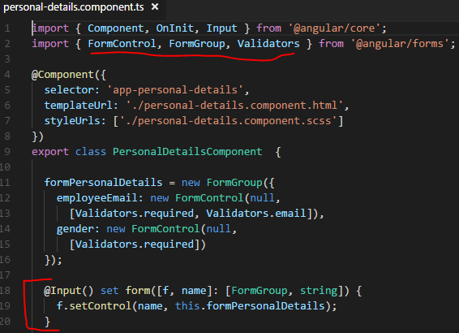

Slide 5
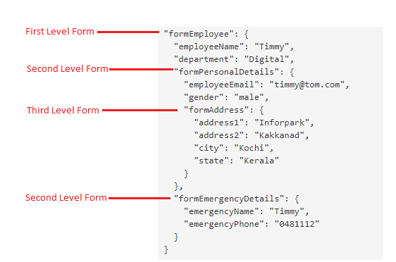
this.formEmployee.getRawValue()
this.formEmployee.valid
this.formEmployee.reset()

Slide 6
Thank you
https://github.com/timmyktom/angular-hierarchy-forms

